Slide 1

Replicating Statistical Analysis Group 4: Raphael Kirchgäßner, Brian Karlberg, Meenakshi Mishra
Verbal monitoring in Parkinson’s disease: A comparison between internal and external monitoring Hanna S. Gauvin, Jolien Mertens, Peter Marien, Patrick Santens, Barbara A. Pickut, Robert J. Hartsuiker

Slide 2
Summary of the paper
Patient population – 18 PD patients; 16 age matched controls; native Dutch speaking
Simple research questions
Is verbal monitoring impaired in patients with Parkinson’s disease (PD)
Can internal tasks on speech perception predict internal monitoring performance?
Definition of key constructs
Internal vs. external monitoring
Pre/post articulation monitoring routes
Internal mechanism theories: perception or production based
Insights from other neurological disorders (Alzheimer’s, stroke, etc.)
Semantic vs. phonological impairments, syntactic complexity, etc.
Notes:
Bias in study design :
Non-random study design
Physicians who diagnosed the patients as fourth and fifth authors
Control patients were partners of PD patients
Study location for 1 PD patient and 4 control patient – home (vs Hospital)
Bias during data analysis
“To compare reaction times, incorrect trials and trials that deviated more than 2 SD from the mean per condition were removed from the data set”
Grammatical errors
Prosody – intonation
Phoneme – distinct sounds
Meta result: PD patients do not differ in verbal monitoring performance rather they differ in how they achieve verbal monitoring.
Control variable results
Pos corr Hoehn and Yahr and MMSE, r=.54 , p=.044
Significant correlation between age and Hohn Yahr, age and MMSE p=.009, and Length of Parkenson’s p=.02, and deep brain STN stimulation p=.008
Negative correlation between age and MMSE -.343, p=.047
Speech production
No significant difference between PD and control group based on most individual correlations
Internal speech perception
Rhyme judgment task
Homophone decision task
Phoneme monitoring task
External speech perception
Rhyme judgement task
Network perception task
Verbal monitoring variables
Disfluencies
Relationship

Slide 3
Brief overview of measurement methods
Key method: noise masking to block external monitoring
Route to investigate functionality of internal monitoring
Regression to predict monitoring performance based on measures of production and perception
Unified Parkinson’s Disease Rating Scale n=18, control group n=16
11 language tasks grouped into 4 categories:
Speech production
Internal speech perception
External speech perception
Verbal monitoring
Notes:
Fill out regression conclusions

Slide 4




Methods (continued)
Boston Naming Test (BNT)
Controlled oral word association test (COWAT)
Cognitive performance tests
Mini mental state examination (MMSE)
Raven Matrices
Software and hardware:
E-Prime and PowerPoint running on laptop
Cedrus RB-x30 response box
Sennheiser HD 250 over-ear headphones
Roland R-1 mp3 recorder

Slide 5
Issues identified in data quality review
Raw table data apparently labeling fractions as percentages – (percentage of semantic error repaired)
Understanding what the data variables represented – examples:
Lepodova
Hoehn Yahr Scale
MMSE
Gender variable coded as one or zero, m and v elsewhere
Potential for geographic bias (Belgian dialects)
Small sample size < 30

Slide 6
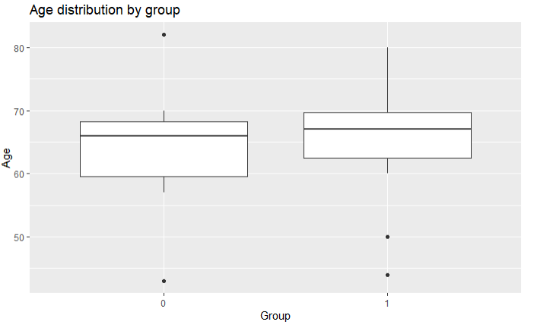
EDA highlights, focusing on why each plot/data summary table was done, and what was learned
Notes:
Not quite age matched control population 5 controls and 4 patients were dropped from the study.

Slide 7
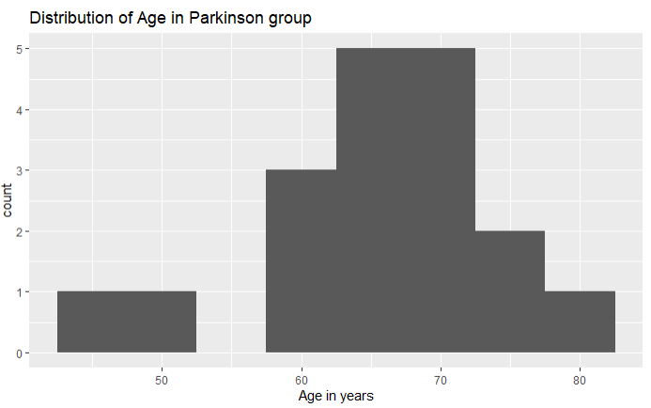
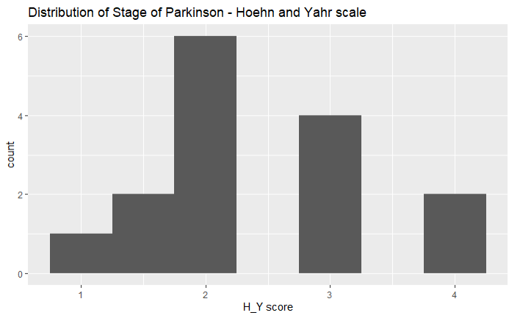
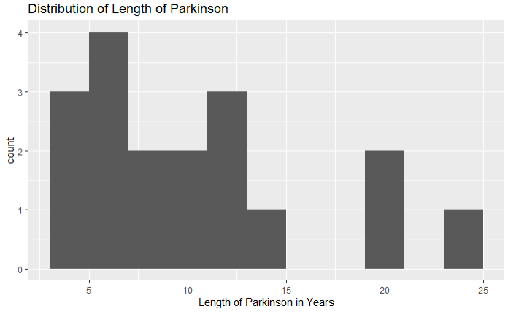
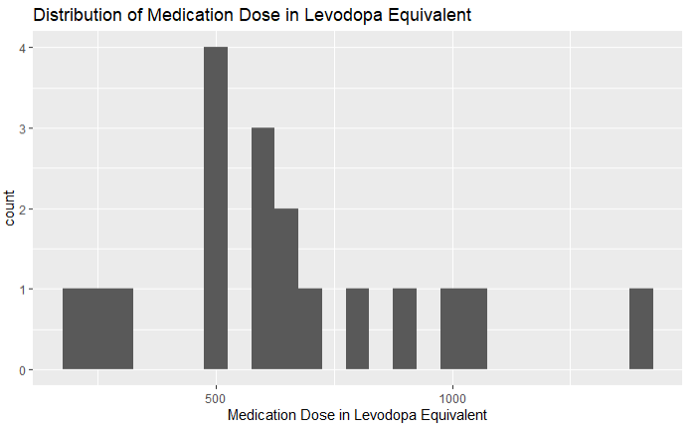
EDA highlights, focusing on why each plot/data summary table was done, and what was learned
Notes:
Highly skewed distribution of length of Parkinson and Medication – again a problem due to small n. More appropriate to consider median rather than mean for length of Parkinson and Medication.

Slide 8
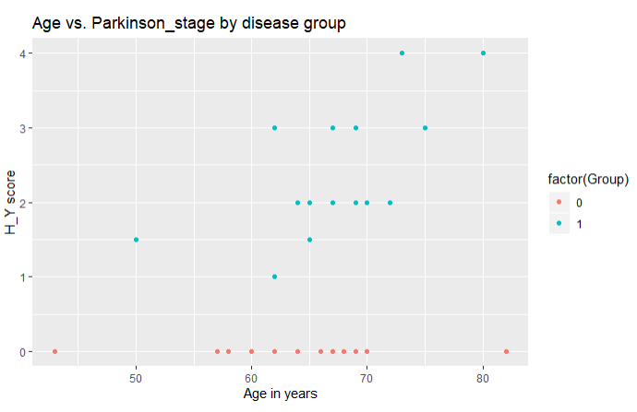
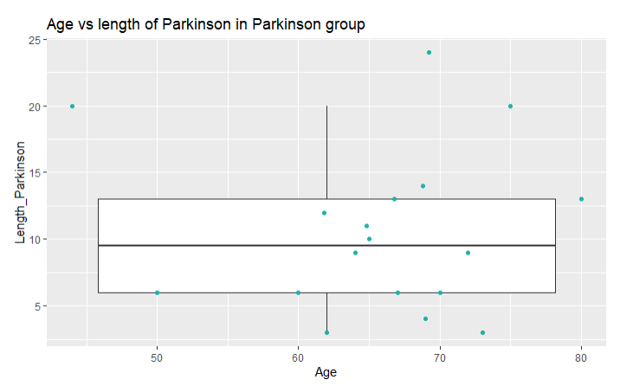
EDA highlights, focusing on why each plot/data summary table was done, and what was learned
Small sample size and wide variation in age, disease state & Length of disease
Notes:
We generated scatter and boxplots to look at the variability in the length of Parkinson in the disease group. Subjects with Parkinson have a wide variation in the length of disease. It is interesting to see that there is at least one person under 50 with length of Parkinson of 20 years. The heterogeniety in the patient population with respect to the length of disease is remarkable, from 5 to almost 25 years.

Slide 9
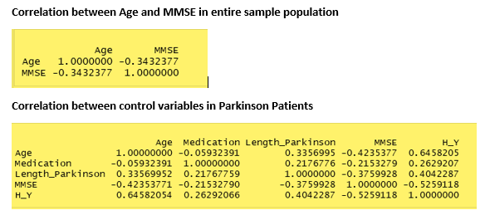
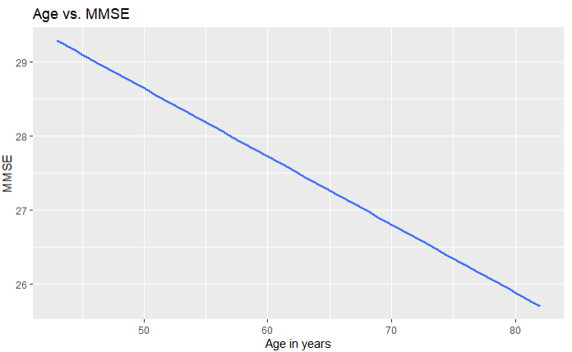
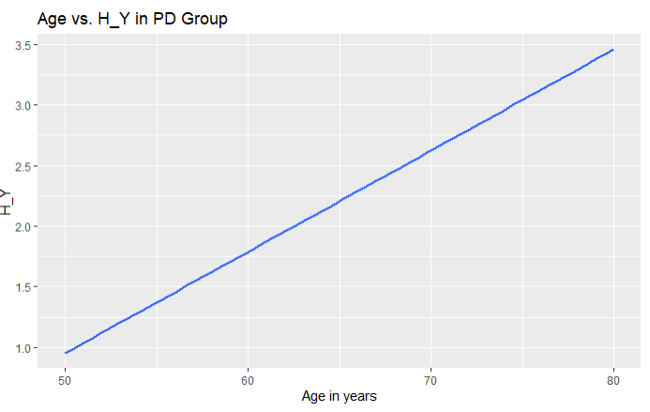
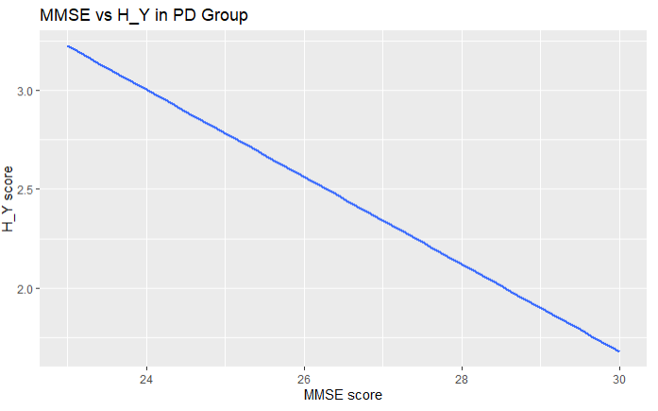
Correlation between control variables
Notes:
A comparison with the norms for Belgian elderly, as presented in the Tables A-B in S1 File, shows that both groups scores fell within the normal range.
Age and performance on the MMSE were negatively correlated, r(34) = -.343, p = .047.
Hoehn & Yahr scales correlate significantly with performance on the MMSE (r(15) = .526, p = .044).
Furthermore for the PD group positive correlations were found between:
age x score on the Hoehn Yahr scale r(15) = .646, p = .009,
age x MMSE, r(18) = .544, p = .020, and
length of Parkinson’s disease x implanted deep brain STN stimulation, r(17) = .617, p = .008. – not shown in the paper.

Slide 10
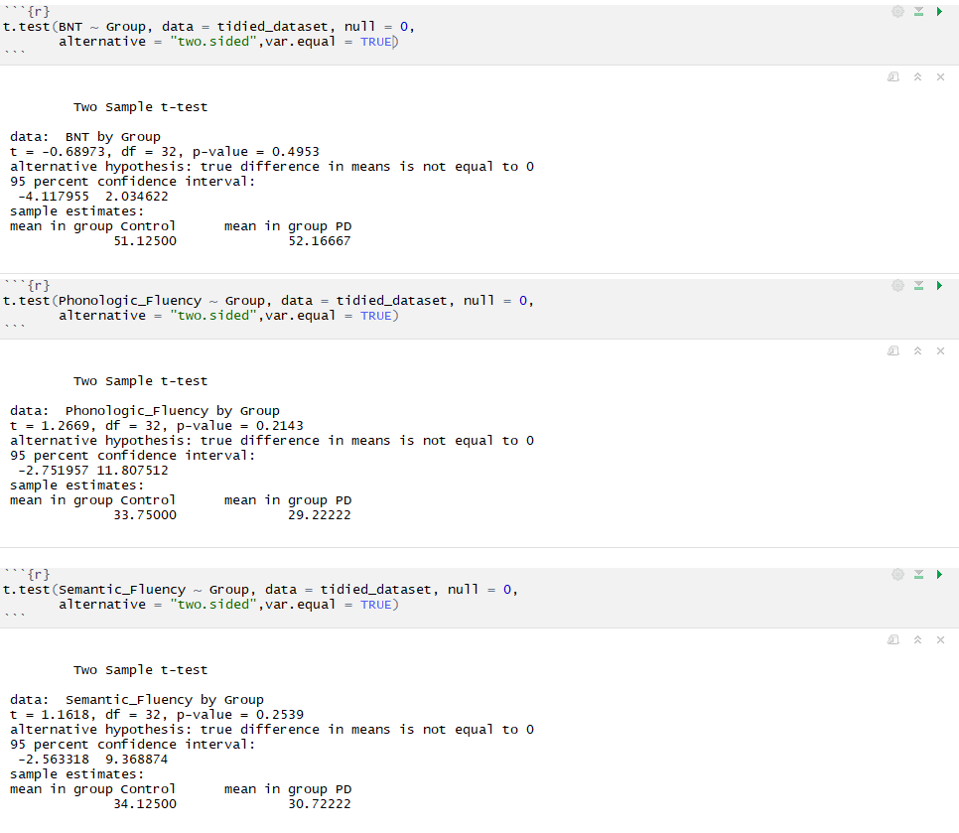
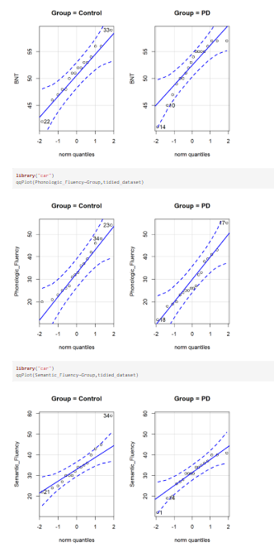
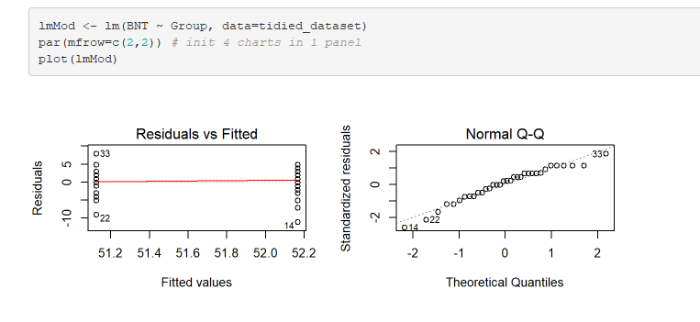
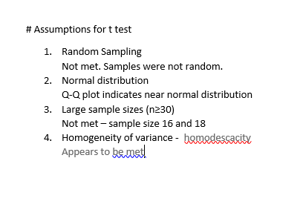
Speech production variables – BNT, COWAT
Notes:
Overall there was no difference in the speech production variables between the healthy group and the PD group.
COWAT – Controlled Oral Word Association Test

Slide 11
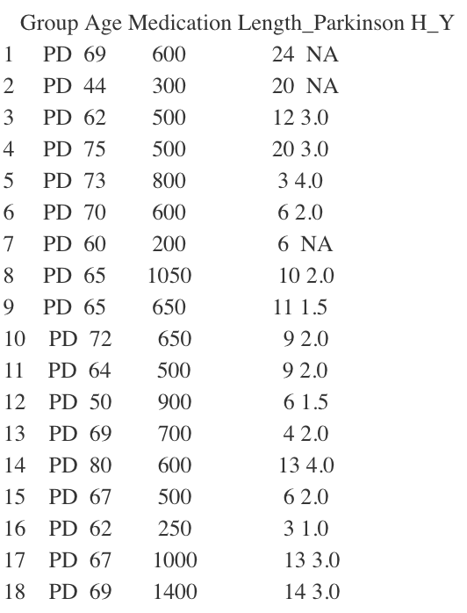
Table 1
Using the tidies dataset
Filter for group == PD
Selected 5 columns
Notes:
"Group","Age", "Medication", "Length_Parkinson","H_Y"

Slide 12
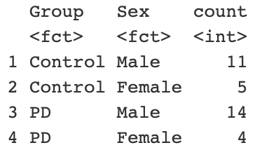
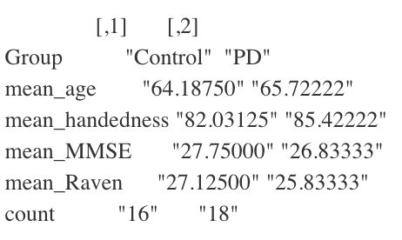
Table 3
Used the tidied dataset
Selected 6 columns
Grouped by “Group”
Used a separate table to show the amount of males and females in each group
Notes:
"Age", "Sex", "Handedness","MMSE","RAVEN","Group"

Slide 13
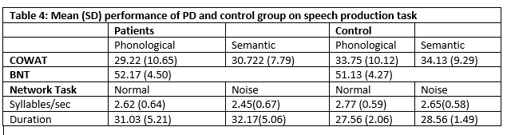
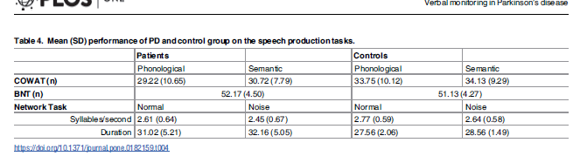
Table 4: Mean (SD) performance of PD and control group on the speech production task

Slide 14
Table 9
Using tidied dataset
Selected seven columns using select
Used gather to collect columns into a dictionary with the Error_type as key and the according value is named total_number
Notes:
We selected seven columns: Group”,“Nrm_Reformulation”,“Nrm_FilledPause”,“Nrm_Repetition”,“Nois_Reformulation”,“Nois_FilledPause”, “Nois_Repetition”

Slide 15
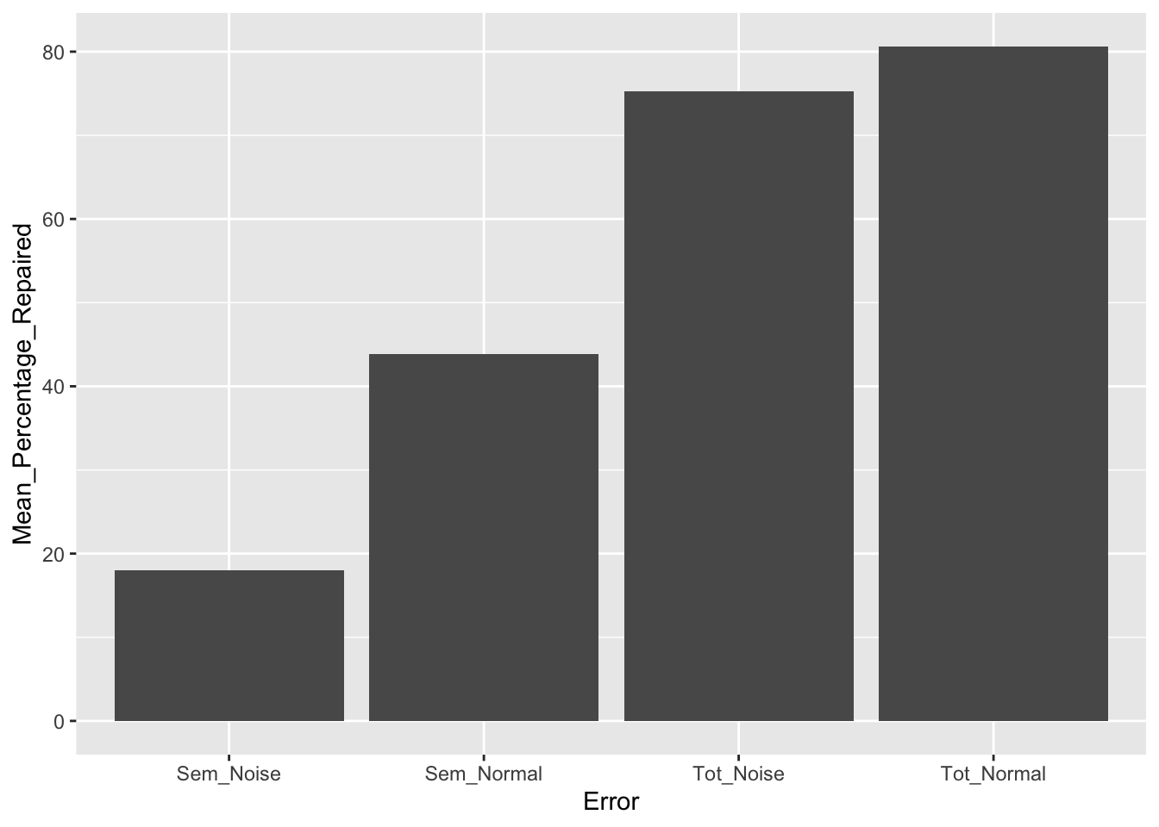
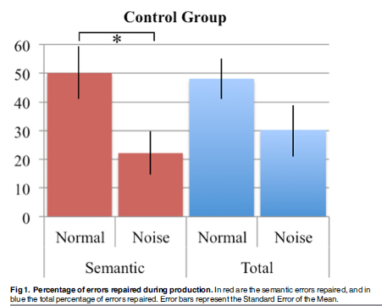
Figure 1. Percentage of errors repaired during production in Control group

Slide 16
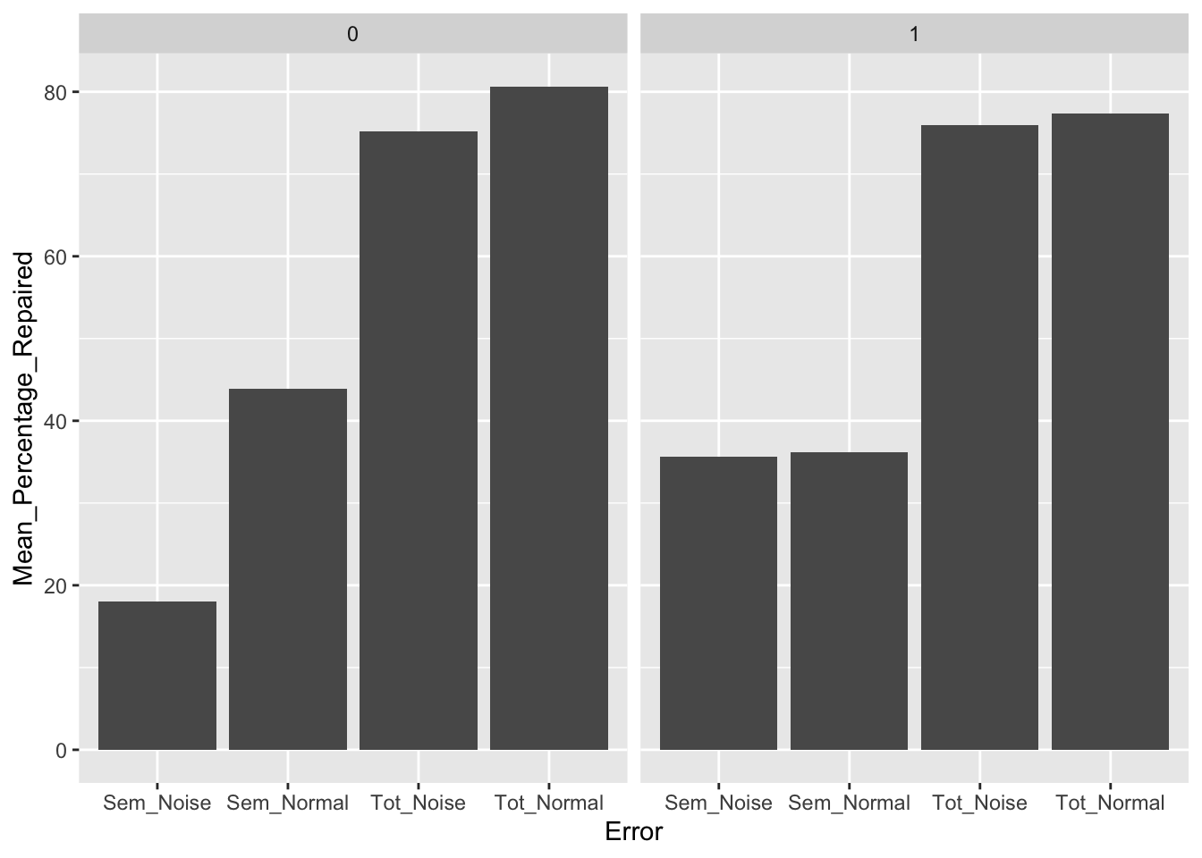
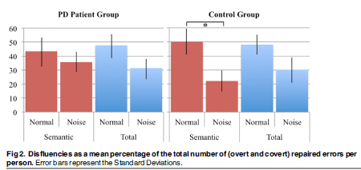
Figure 2. Disfluencies as a mean percentage of the total number of (overt and covert) repaired errors per person.

Slide 17
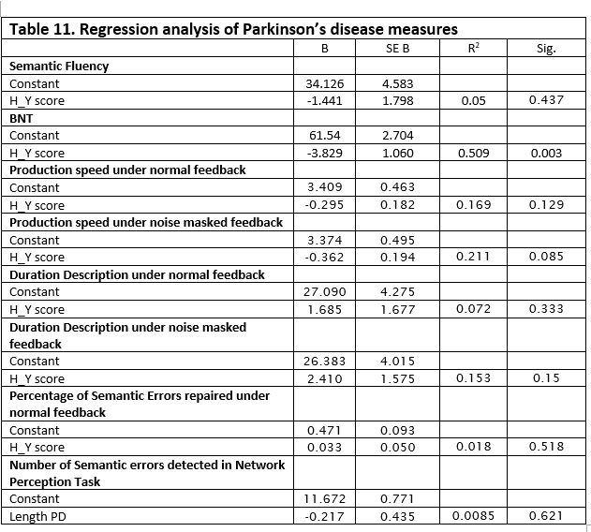
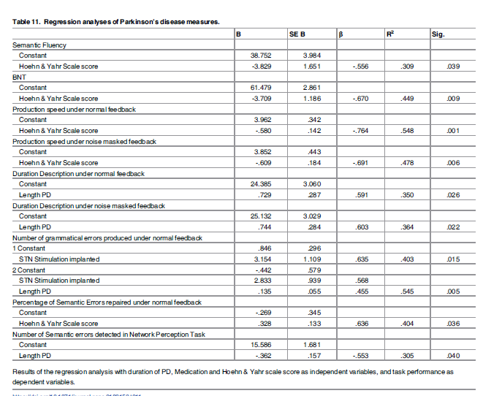
BNT was the only task that was significantly affected by Parkinson disease measure (H_Y)

Slide 18
Three biggest takeaways from doing this project
Structured methods and tools exist for analyzing speech in neurodegenerative disease models
Transparency in data collection, use and analysis is critical to successful reproduction of results
The combination of input data and method of analysis can result in drastically different conclusions
Notes:
Literature review and comparisons embedded throughout paper

Slide 19
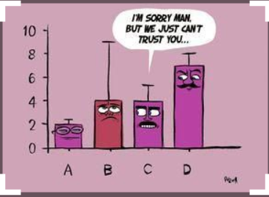
Thanks & Questions
https://www.pinterest.com/pin/AQReyoNMTbVC63d76N5VJfi_NCvU_TjaAvdGF62zj_6UFHKjK1Nz1Y0/visual-search/?cropSource=6&h=206&w=290&x=10&y=10

